Slide 1

Bypassing external authentication in ingress-nginx
Marcin Niemiec

Slide 2


About me
Blog: https://xvnpw.github.io
Twitter: https://twitter.com/xvnpw
Github: https://github.com/xvnpw

Slide 3
Introduction
Rule nr 1: questions at the end
Who knows/uses Kubernetes?
Who knows/uses ingress-nginx?
Who knows/uses external authentication in ingress-nginx?

Slide 4
Path traversal in ingress
http://example.com/A/../B/endpoint
A
B
/../B/endpoint
/endpoint

Slide 5
Path traversal in ingress
http://example.com/A/../B/endpoint
Emissary (envoy)
Traefik
HAProxy
Ingress-nginx
Kong
F5 NGINX
A
B
/../B/endpoint
/endpoint

Slide 6
Bypass of external authentication
Corner case of specific setup
Is not wrong on purpose
One of main reasons: poor documentation
Apache APISIX CVE-2021-43557
HackerOne report: https://hackerone.com/reports/1357948
Github issue: https://github.com/kubernetes/ingress-nginx/issues/8644

Slide 7
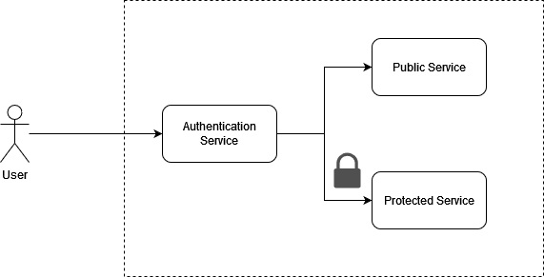
Example architecture
All user requests are going through an authentication service
Centralize place to decide if the request is allowed or not

Slide 8
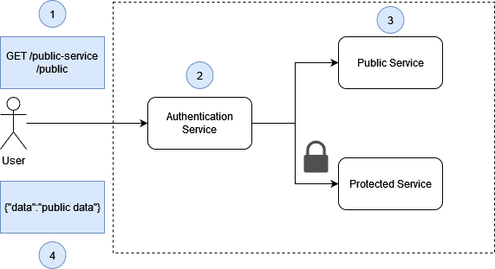
Request for Public Service
Request for Public Service resource
Authentication Service permits all requests to Public Service
Public Service handles the request
User gets response

Slide 9
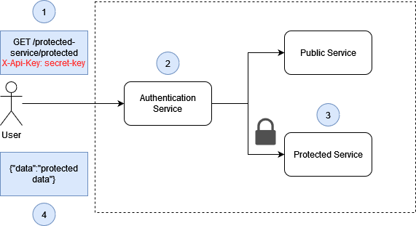
Request for Protected Service
Request for Protected Service resource using X-Api-Key
Authentication Service permits request with correct X-Api-Key
Protected Service handles request
User gets response

Slide 10
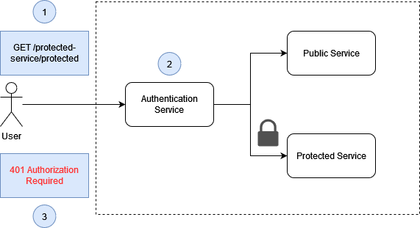
Authentication failed
User requests for Protected Service resource – with no authentication
Authentication Service rejects request without correct X-Api-Key
User gets 401 response

Slide 11
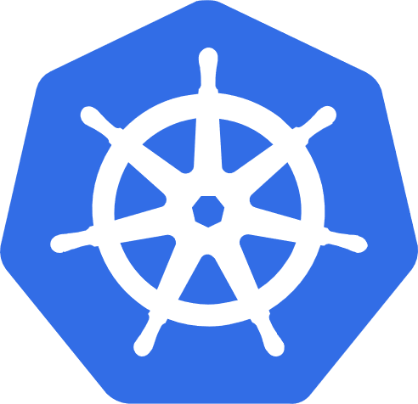

Building blocks explained
Kubernetes
Pod
Kubernetes is deployment platform. It makes easy to configure and run containers
Pod is smallest deployable/execution unit in Kubernetes. In our case we can think about it as container + configuration

Slide 12

Building blocks explained
Ingress
Service
Ingress is an API object that provides routing rules to manage access to the services
Kubernetes service is a logical abstraction for a deployed group of pods in a cluster

Slide 13
Building blocks explained
Ingress vs Ingress controller?
Ingress is an API object. Ingress-controller is reverse proxy, e.g. nginx.

Slide 14
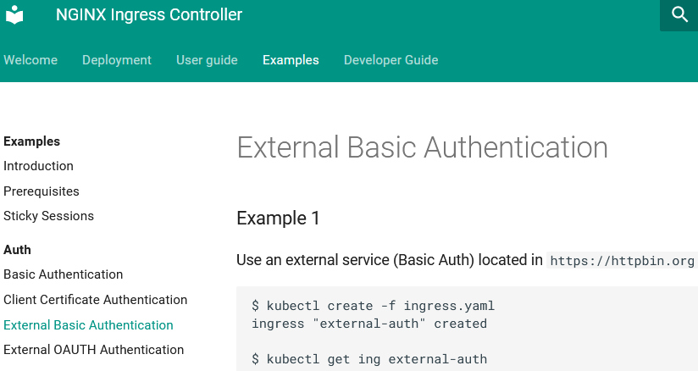
Implementation
There are many ways to implement that, but there is one particular...

Slide 15
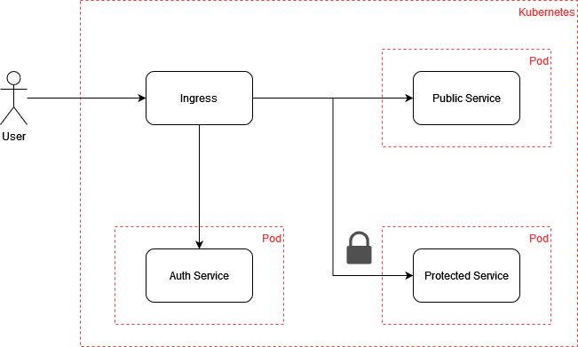
Implementation
We are using external basic authentication feature of ingress-nginx

Slide 16
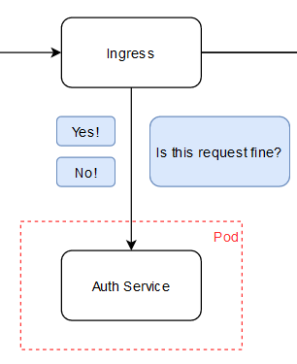
External basic authentication
For every incoming request, Ingress is calling Auth Service for authentication.
Auth Service can return code 401 or 200. If 200 is returned, ingress permits request and for 401 rejects it.

Slide 17
Ingress definition
apiVersion: networking.k8s.io/v1
kind: Ingress
(…)
nginx.ingress.kubernetes.io/rewrite-target: /$1
nginx.ingress.kubernetes.io/auth-url: http://auth-service.default.svc.cluster.local:8080/verify
spec:
(…)
paths:
- path: /public-service/(.*)
- path: /protected-service/(.*)
rewrite-target – removes prefixes
auth-url – points to Auth Service endpoint to which ingress will be sending requests
two paths on one ingress: /public-service/(.*) and /protected-service/(.*)

Slide 18
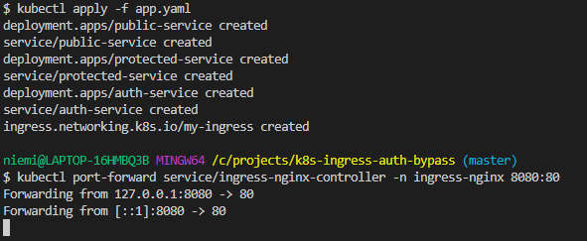
Test it!
Deployment to minikube
Install minikube https://minikube.sigs.k8s.io/docs/start/
Clone https://github.com/xvnpw/k8s-ingress-auth-bypass

Slide 19
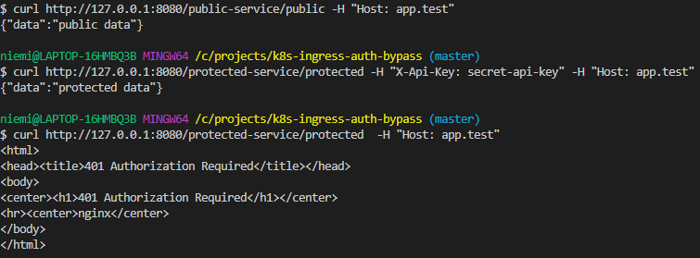

Verification of requirements

Slide 20
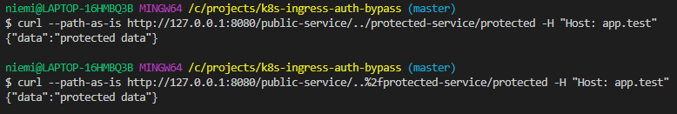

Bypass in action

Slide 21
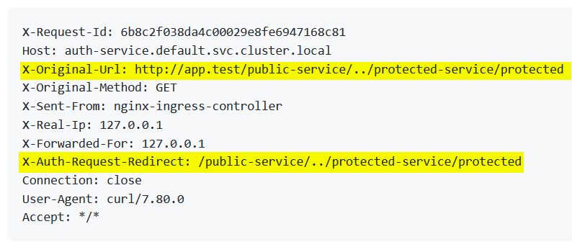
What does exactly ingress-nginx send to Auth Service?
Headers that ingress-nginx sends to Auth-Service

Slide 22
What does exactly ingress-nginx send to Auth Service?
1
2
Those headers are set in ingress-nginx source file nginx.tmpl
$request_uri description in nginx documentation is very short

Slide 23
What does exactly ingress-nginx send to Auth Service?
user request
GET /public-service/../protected-service/protected
ingress-nginx
$request_uri
Auth Service
X-Original-URL

Slide 24
Main observed problems
Root Cause
Ingress-nginx is resolving services based on normalized URIs but sending to basic external authentication not normalize URIs
No documentation about possible security risks in ingress-nginx due to not normalized URIs
Auth Service is not normalizing incoming URIs – RTFM?

Slide 25
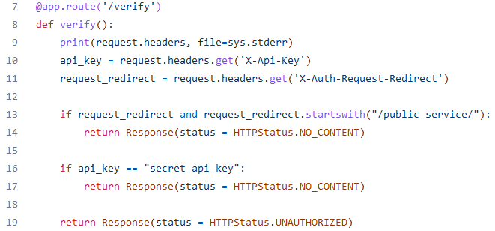
Auth Service is not normalizing incoming URIs – RTFM?

Slide 26
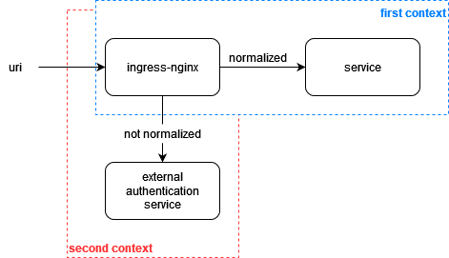
Root cause – bad design
The root cause for this vulnerability is bad design. Ingress-nginx is using normalized URI to choose service, but not normalized in calls to external authentication service

Slide 27


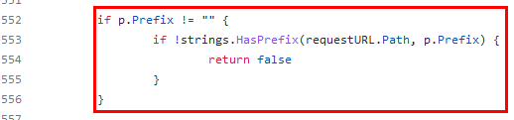

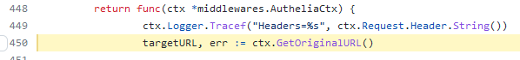
Hunting in github for not-normalized URIs
X-Original-URL and X-Auth-Request-Redirect headers
CVE-2021-43557 in Apache APISIX
Pomerium
Authelia

Slide 28
Other ingress controllers
Ingress Name | Reverse proxy | Vulnerable?
Traefik Kubernetes Ingress | Traefik Proxy | No
HAProxy Ingress | HAProxy | No
Apache APISIX | Nginx | Fixed
Skipper | Skipper | No
Emissary | Envoy | No
Kong F5 NGINX | Nginx | With custom plugin
Only ingress controllers based on nginx are vulnerable
Others are not vulnerable and some like Emissary has documentation about this particular risk

Slide 29
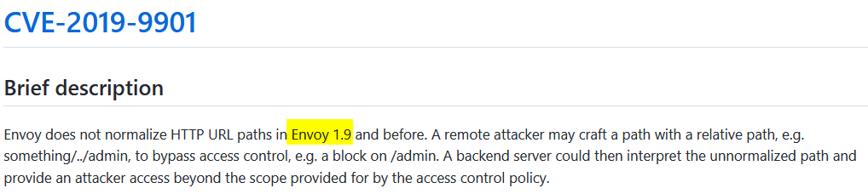
Envoy – well documented risk
https://github.com/envoyproxy/envoy/security/advisories/GHSA-xcx5-93pw-jw2w
https://www.getambassador.io/docs/edge-stack/latest/topics/running/ambassador/#rejecting-client-requests-with-escaped-slashes

Slide 30
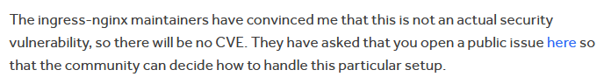

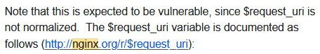
Bad disclosure and fix process
Both from ingress-nginx and nginx itself

Slide 31

…anger leads to CVE
Hunting for $request_uri variable in Apache APISIX
Apache APISIX is using $request_uri in uri-blocker plugin
As $request_uri is not normalized, it’s possible to use path-traversal to confuse it
CVE-2021-43557

Slide 32
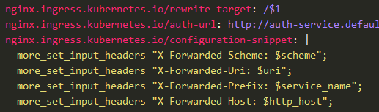
Mitigations
Defense in depth – all inputs should be validated, sanitized and encoded to context
In ingress-nginx you can:
Split ingress definition into multiply ingresses
Normalize URI before usage in Auth Service – can you be sure that your implementation of normalization is same as nginx ?
Use the $service_name variable like this:

Slide 33

Summary
Check your project for using X-Original-Url, X-Auth-Request-Redirect headers and $request_uri variable
Don't trust inputs, especially in sensitive context
HackerOne report: https://hackerone.com/reports/1357948
Github repo: https://github.com/xvnpw/k8s-ingress-auth-bypass

Slide 34


Slide 35

THANK YOU!

